Slide 1

Concepts of Biostatistics & Biological Data
BioData Training School 2025
December 10-13, 2025
University of Tirana, Albania

Slide 2
Outline
What is Biostatistics?
Why biostatistics matters?
Key concepts
Biological data types
Descriptive statistics
Probability & inference
Core statistical methods
Sample size calculation
Notes:
Here you add the wooclap link to ask them questions about their background and basic knowledge in biostatistics

Slide 3
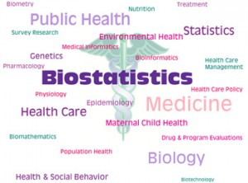
Definition of Biostatistics
Biostatistics is a branch of applied statistics that applies statistical methods to collect and analyze data related to biology and medicine.
--- Much more statistics than biology and medicine, however, biostatisticians must learn some biological and medical concepts also.

Slide 4
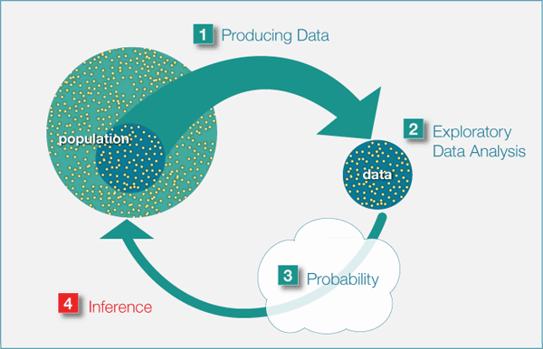
Aim of Biostatistics
Draw conclusions about a population based on the data obtained from a sample chosen from it.
Source: UF-Open learning

Slide 5
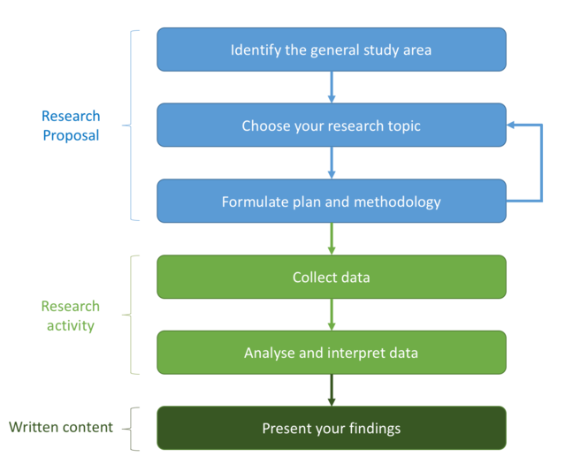
Biostatistics in research
A good way to learn about biostatistics and its role in the research process is to follow a research study from study design to its publication.
The biostatistician should be present in all steps.

Slide 6
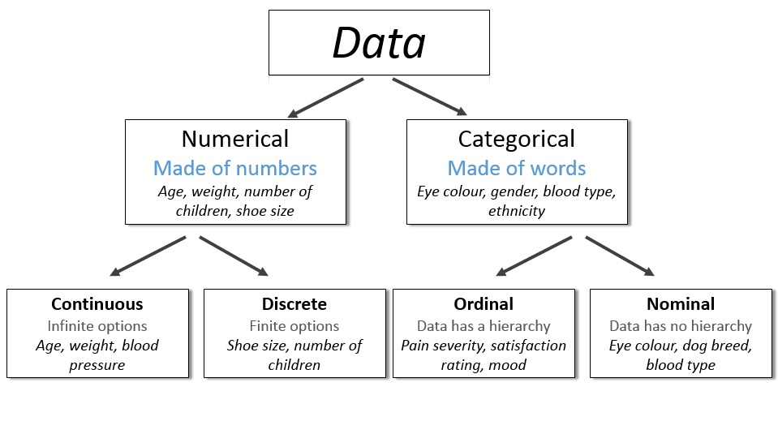
Types of variables in biostatistics
A random variable is a characteristic that can take on different values for different individuals, places or things.
Image by Freepik

Slide 7
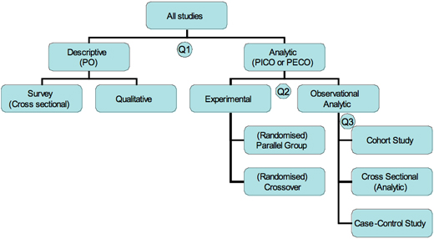


Data collection/Study design
Q1. What was the aim of the study?
Q2. If analytic, was the intervention randomly allocated?
Q3. When were the outcomes determined?
https://www.cebm.ox.ac.uk/resources/ebm-tools/study-designs

Slide 8
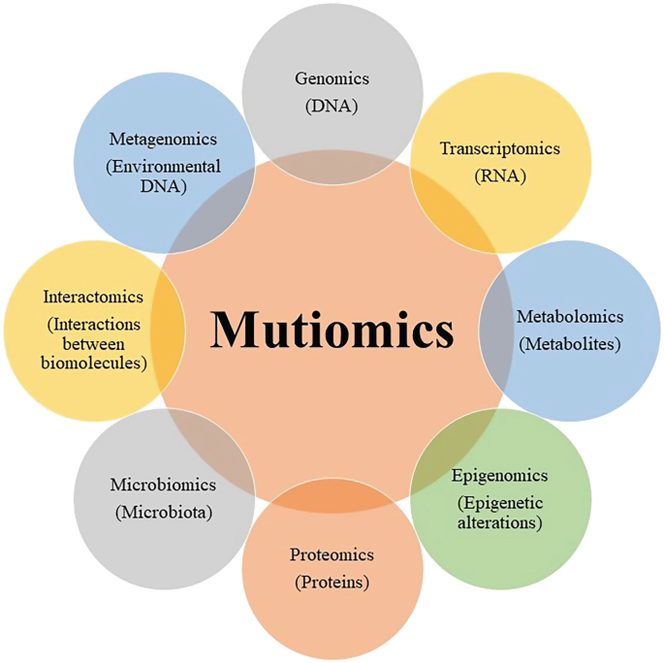
Biological & Health data
Clinical & epidemiological data (blood pressure, BMI, disease status, incidence rates, etc)
Laboratory measurements (enzyme activity, hormone levels, cell counts, etc)
Omics data (Genomics, Transcriptomics, Metabolomics)
Imaging data (MRI scans, microscopy images, CT images)
https://doi.org/10.1007/978-981-97-1844-3_16

Slide 9
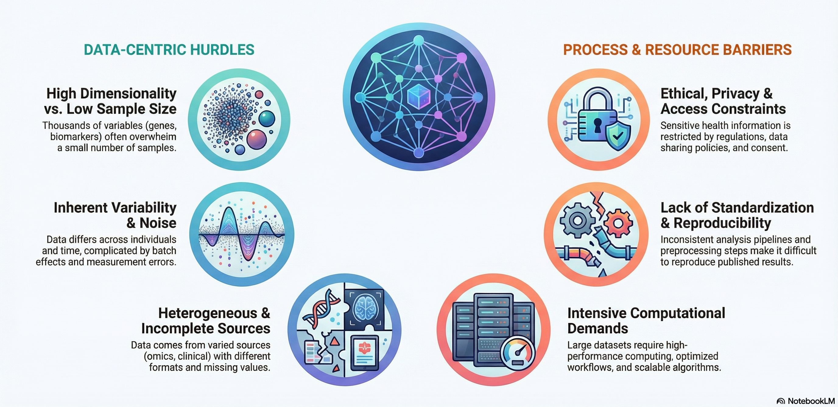
Biological Data: Key Challenges

Slide 10
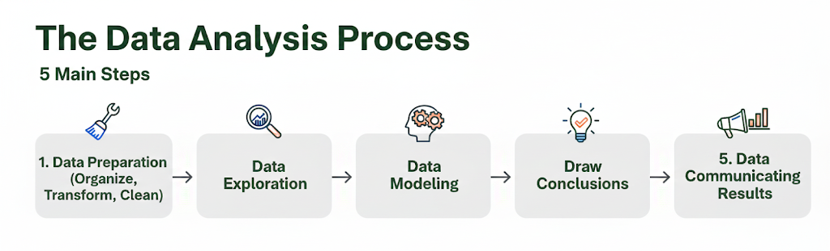
- Data preparation includes editing, coding, and data entry in forms that are appropriate for analysis.

Slide 11
Data exploration
Nominal variables
Frequency
Count (How frequent values occur)
Relative (The % of observations with a specific value)
Numerical variables
Descriptive statistics
Mean, Mode, Median
Variance, Standard deviation, SE
Range, Percentiles

Slide 12
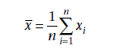
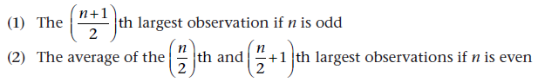
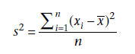
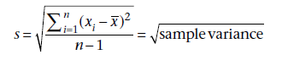
Descriptive statistics
Arithmetic mean
Median
Variance
Standard deviation
Fundamentals of Biostatistics – Chapter 2

Slide 13
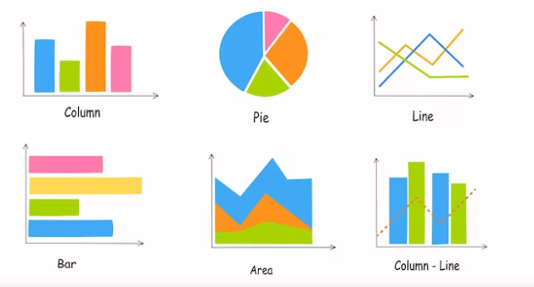
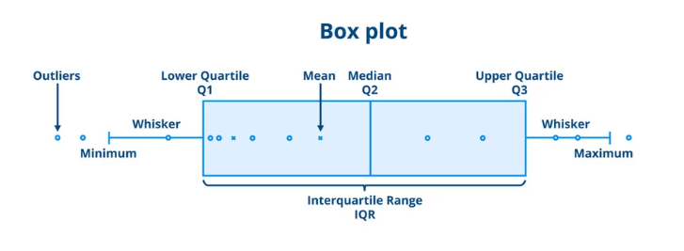
Graphical visualizations
<Link to previous learning>
<Link to future learning>
<Link to other teaching session in module>

Slide 14
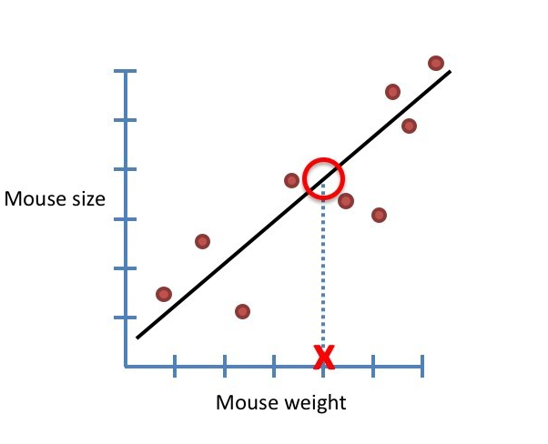
Statistical modeling
“A statistical model is usually specified as a mathematical relationship between one or more random variables and other non-random variable and represents, often in considerably idealized form, the data-generating process” (Wikipedia).
Includes
T-tests
ANOVA
Linear Regression
Generalized linear models
And many more…

Slide 15
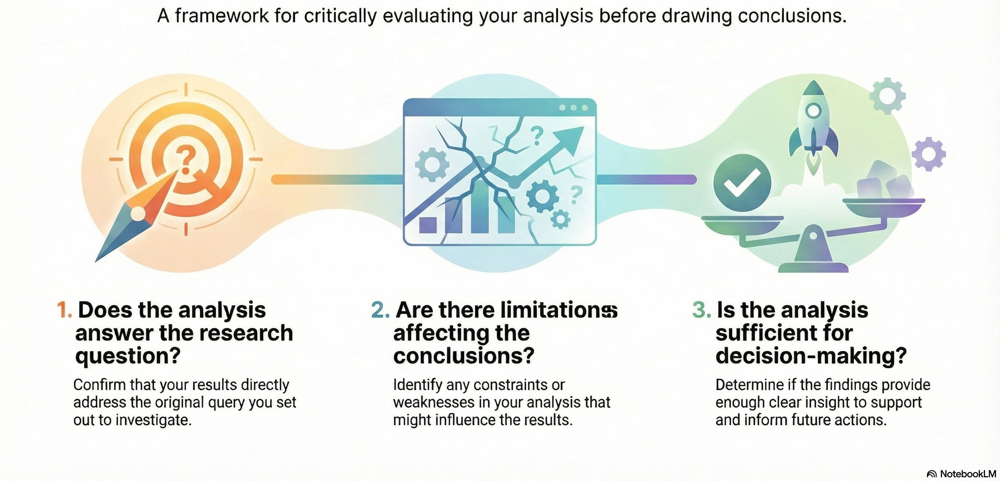

Draw conclusions

Slide 16

Communicate the results
Now it’s time to communicate your findings
Documentation of statistics
Making presentations
Writing reports, manuscripts
Extra skills needed at this stage
Writing
Presenting
Communication

Slide 17
Statistical inference
Statistical inference: draw conclusions about a population based on the data obtained from a sample chosen from it.
Point Estimation
Interval estimation
Hypotheses testing
Source: UF-Open learning

Slide 18
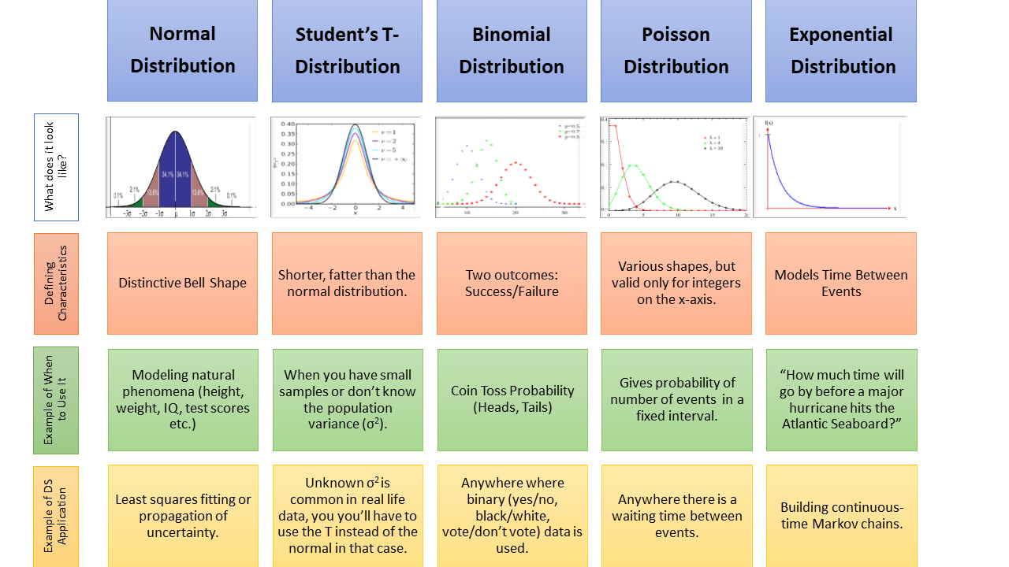
Statistical inference is based on probability distributions
To fully understand the theory behind statistical inference you will need some concepts related to probability distributions.
If you haven’t taken any course in statistical theory during your studies, I recommend you check this great book by Rosner (2010).
Source: Data Science Central

Slide 19
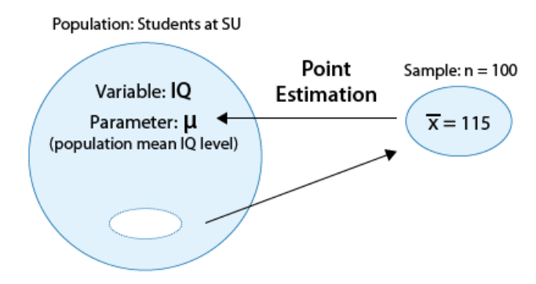
Point Estimation
In point estimation, we estimate an unknown parameter using a single number that is calculated from the sample data.
Point estimates are totally unbiased estimates for the population parameter only if the sample is random and the study design is not flawed.
More on: UF-Open learning

Slide 20
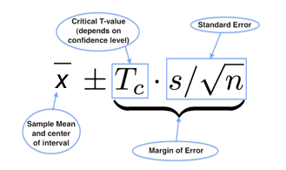
Interval estimation
In interval estimation, we estimate an unknown parameter using an interval of values that is likely to contain the true value of that parameter.
For example: We are 95% confident that μ for IQ in the previous sample is covered by the interval (112, 118).

Slide 21
Statistical hypothesis testing
Statistical hypothesis testing is defined as:
Assessing evidence provided by the data against the null hypothesis.
Step 1
Formulate the hypotheses:
Step 2
Collect relevant data and summarize them.
Step 3
Compute p-value and make our decision.
Step 4
Test how likely it is to observe data we obtained, if null hypotheses is true. Compute test statistics
H₀ – null and H₁- alternative
Notes:
The null hypothesis, denoted by H0, is the hypothesis that is to be tested. The alternative hypothesis, denoted by H1 is the hypothesis that in some sense contradicts the null hypothesis.

Slide 22
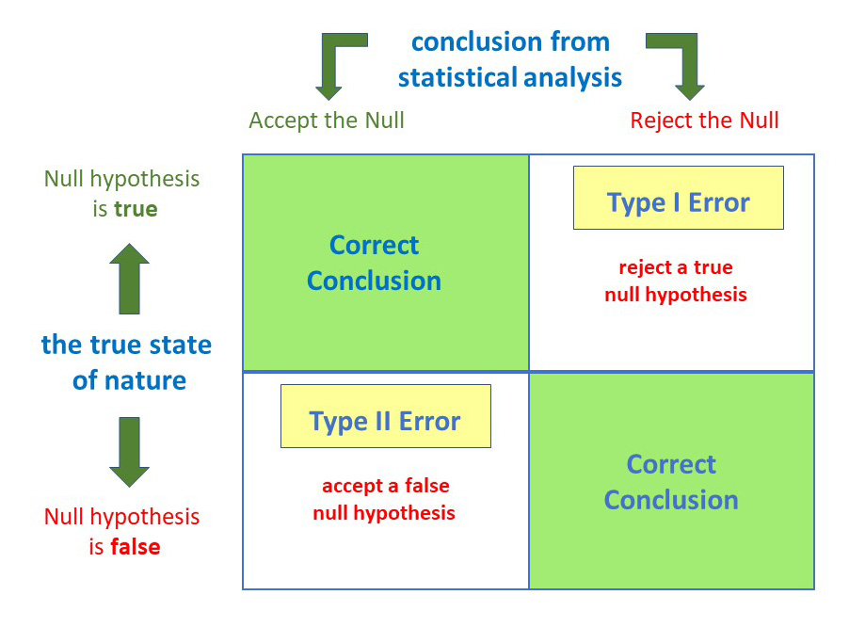
Hypotheses testing: Type I and II errors
The probability of a type I error is the probability of rejecting the null hypothesis when H0 is true. Is denoted by α and is commonly referred to as the significance level of a test.
The probability of a type II error is the probability of accepting the null hypothesis when H1 is true. Is denoted by β and is highly affected by the sample size.
The power of a test is defined as 1 - β
or 1 - probability of a type II error = P(rejecting H0|H1 true)
Image source: simplypsychology.org

Slide 23
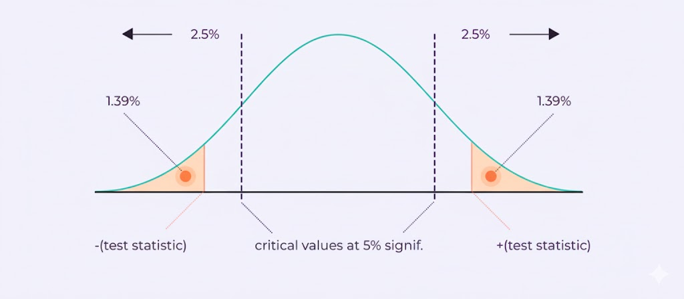
P-value
A p-value (probability value) in statistics measures the likelihood of observing your data (or more extreme data) if the null hypothesis (no real effect/difference) were true.
A small p-value (e.g., < 0.05) suggests strong evidence against the null, implying the results aren't just random chance, while a large p-value means the data is consistent with the null hypothesis.

Slide 24
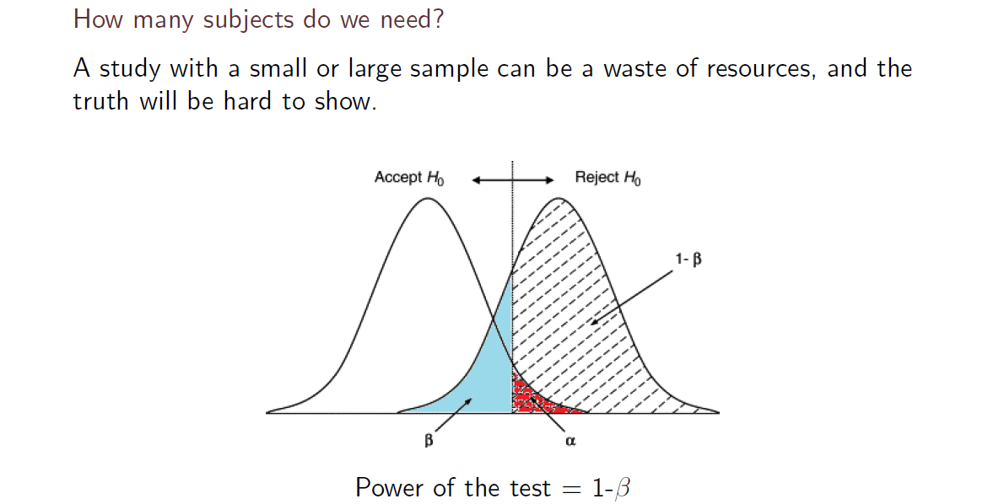
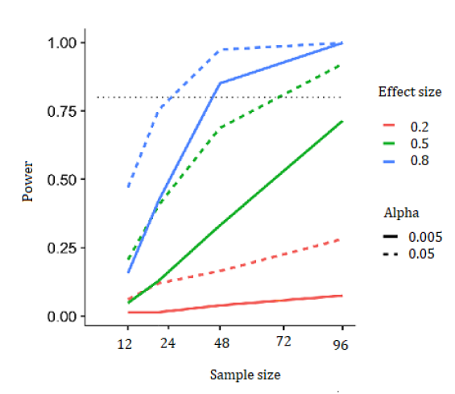
Power and sample size calculation

Slide 25
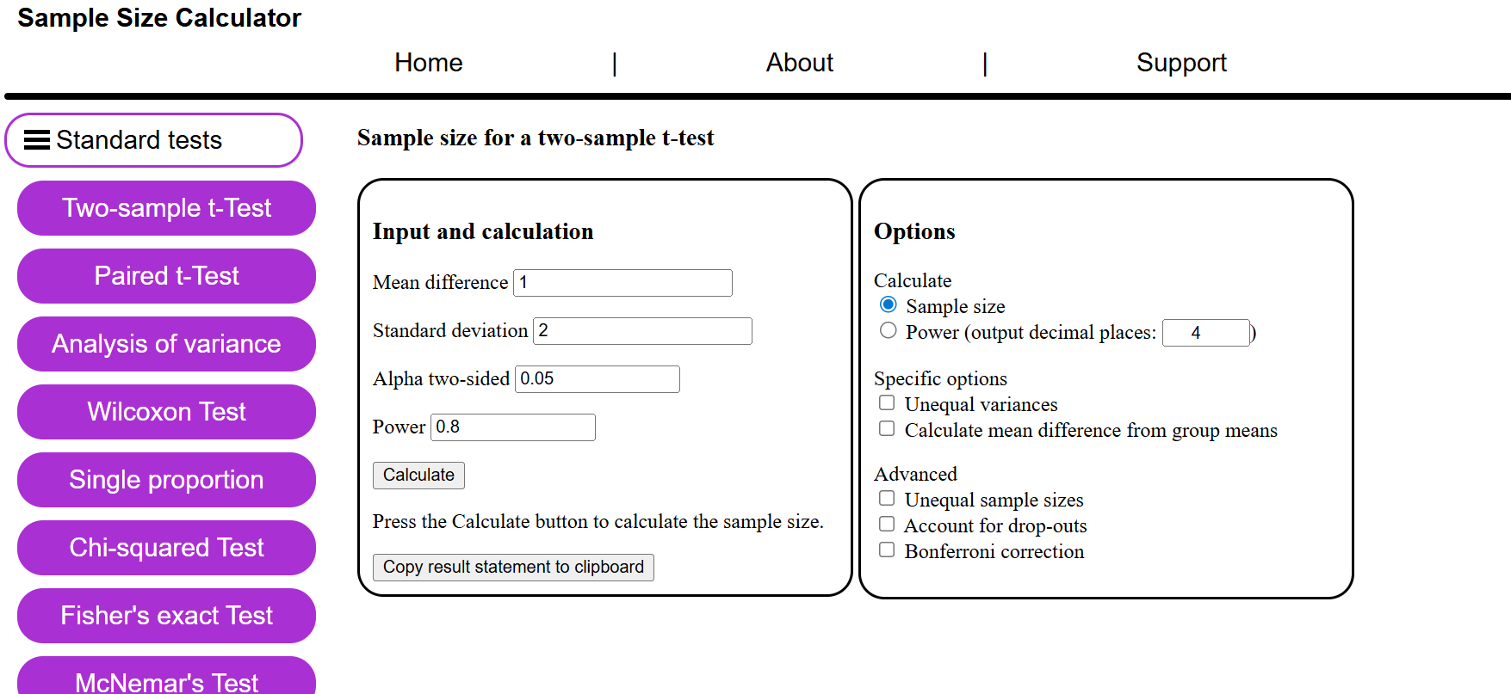
Power and sample size calculation
https://homepage.univie.ac.at/robin.ristl/samplesize.php

Slide 26


Software

Slide 27
Basic Statistical Tests

Slide 28
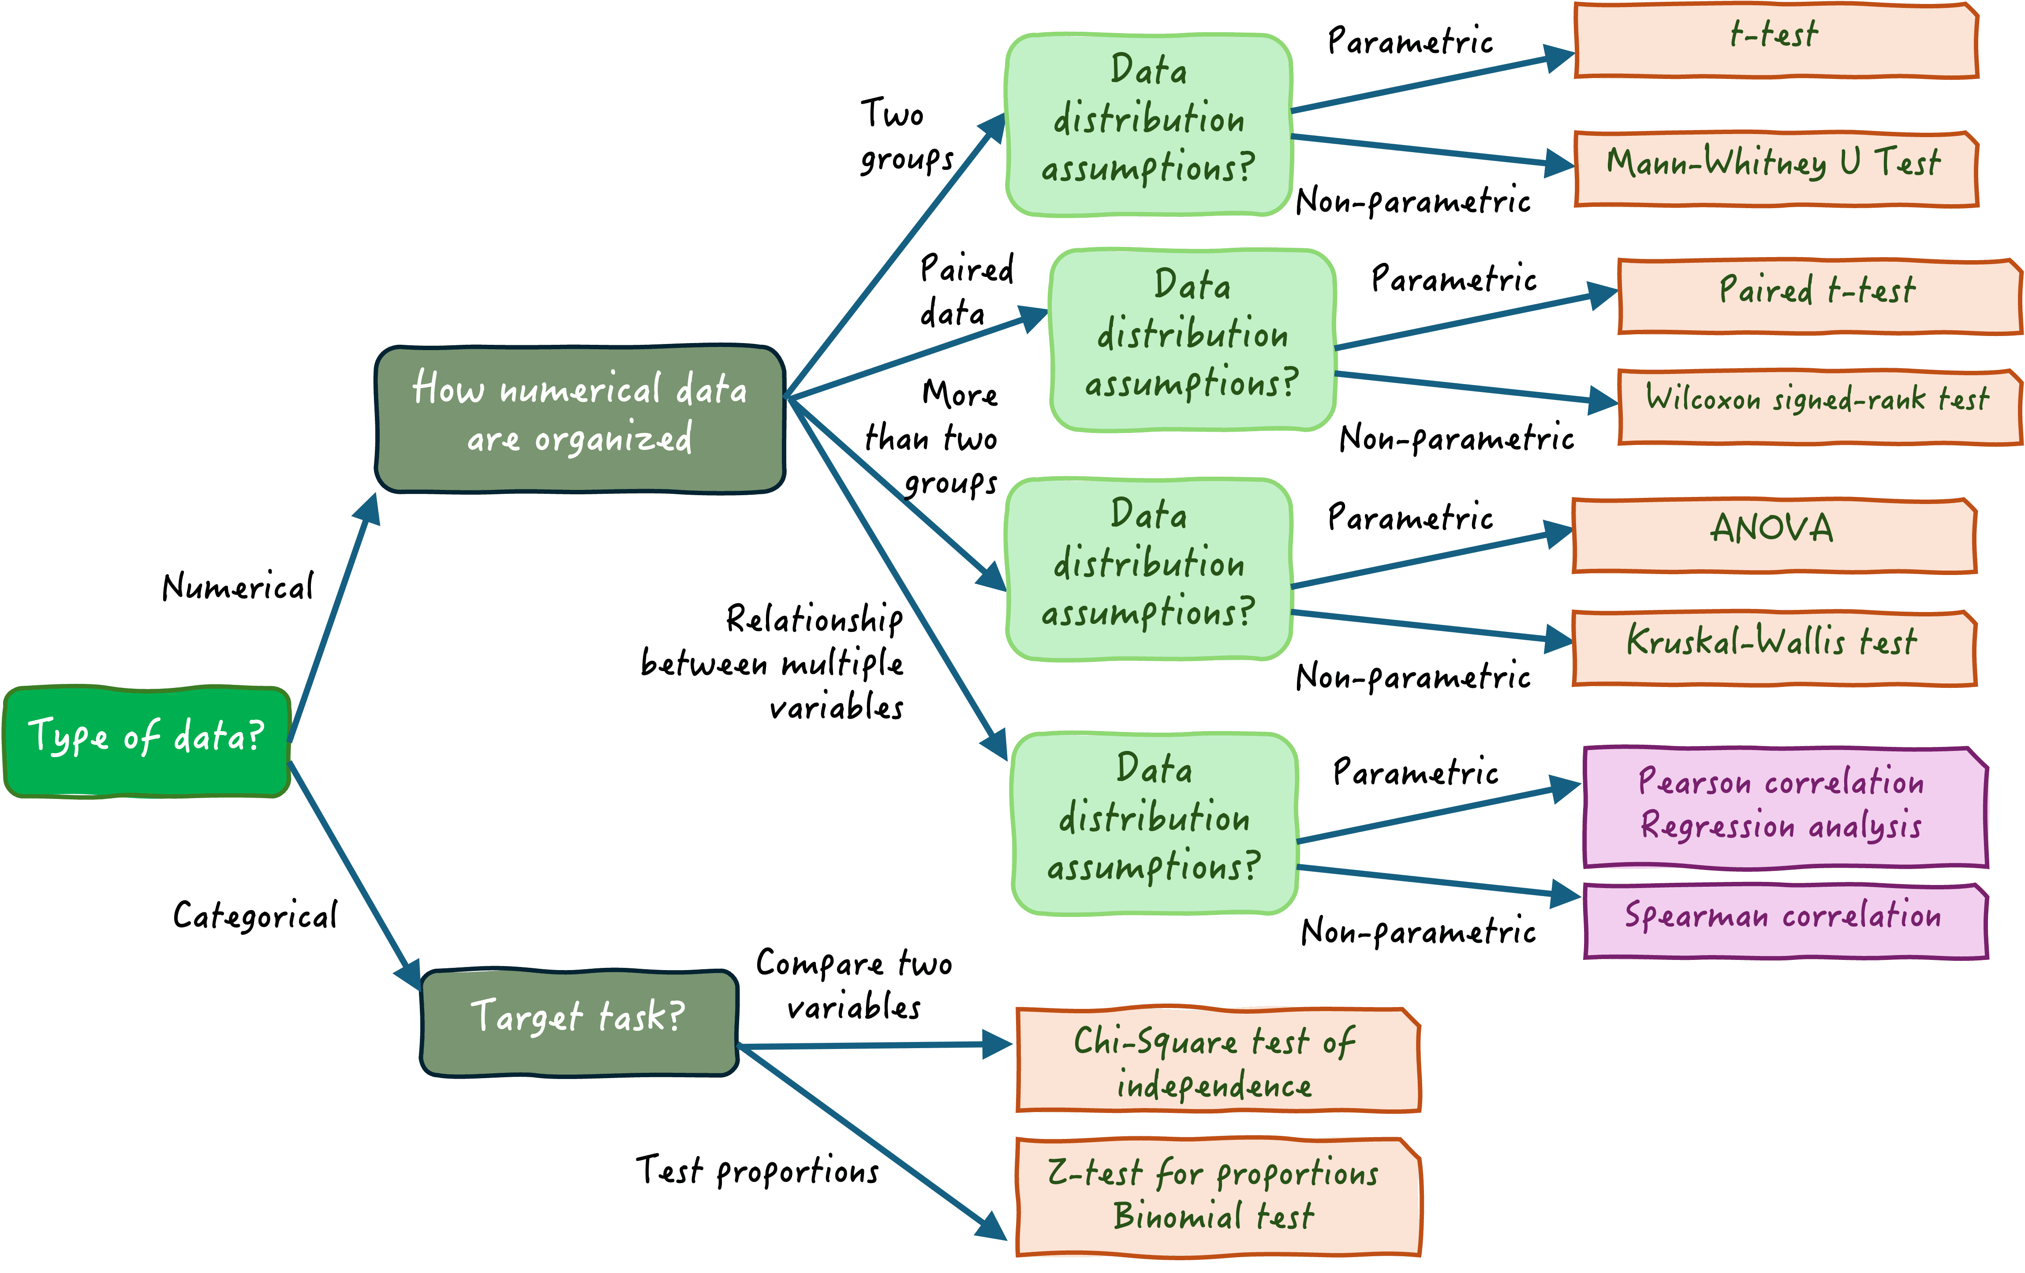

https://www.statology.org/
Notes:
Here you add the wooclap link to ask them questions about their background and basic knowledge in biostatistics

Slide 29
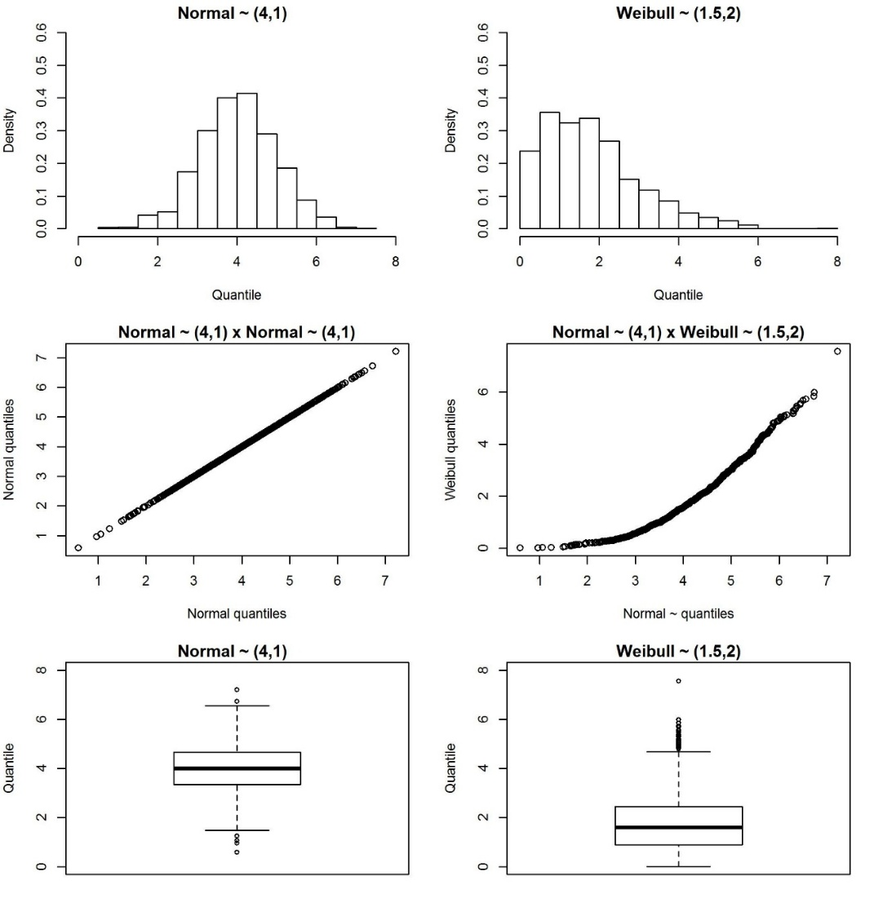
How to test for normality?
Graphically
Histogram
QQ plots
Boxplot
Formal tests
Kolmogorov Smirnov
Shapiro-Wilk

Slide 30
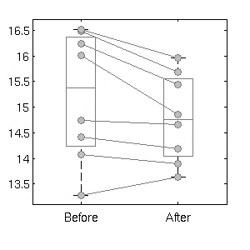
Two related samples

Slide 31
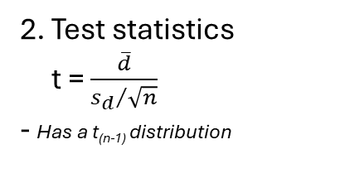
Paired Samples t-test (Parametric)
The paired t-test is used to test whether the mean of a dependent variable is the same in two related groups of the independent variable:
Hypotheses
H₀: Δ = 0 vs. H₁: Δ ≠ 0
Your dependent variable should be continuous.
Your independent variable should consist of two categorical, related groups.
The differences between pairs should be normally distributed
2. Test statistics
t = $\frac{\overline{d}}{{s_{d}}/{\sqrt{n}}}$
- Has a t_{(n-1)} distribution
3. Decision
P-value < 0.05 reject H₀

Slide 32
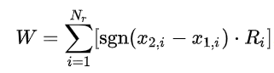
Wilcoxon signed rank test (nonparametric)
3. Decision based on p-value
If p<0.05 reject Ho
If the difference is not symmetric around zero then there is difference between groups.
1. Hypothesis
H₀: difference between the pairs follows a symmetric distribution around zero.
H₁: difference between the pairs does not follow a symmetric distribution around zero.
2. Compute the test statistics (in R)

Slide 33
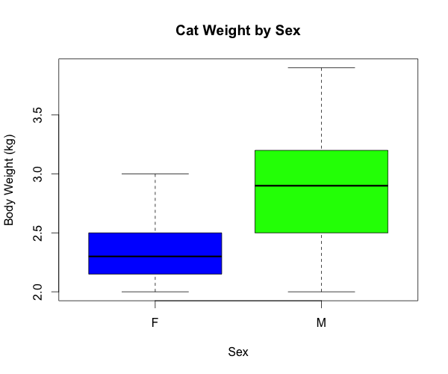
Two independent samples

Slide 34
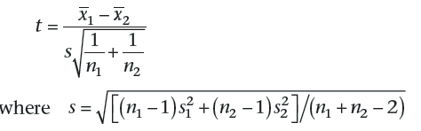
Independent Samples t-test (parametric)
The independent-samples t-test compares the means between two unrelated groups on the same continuous, dependent variable.
Assumptions
Your dependent variable should be measured on a continuous scale.
Your independent variable should consist of two categorical, independent groups (i.e., gender).
There should be no significant outliers.
Your dependent variable should be approximately normally distributed for each group of the independent variable.
Test the homogeneity of variances with Levene test.
Hypotheses
H₀: μ₁ = μ₂ vs. H₁: μ₁ ≠ μ₂
2. Test statistics
~ t_{(n1+n2-2)}
3. P-value < 0.05 reject H₀

Slide 35
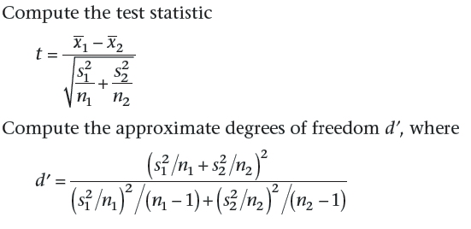
Independent Samples t-test: Unequal variances
Hypotheses
H₀: μ₁ = μ₂ vs. H₁: μ₁ ≠ μ₂.
2. Test statistics
3. Decision
P-value < 0.05 reject H₀
The populations means are significantly different from each other.
~ t_{(d’)} distribution

Slide 36
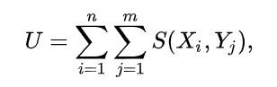
Mann Whitney U test
1. Hypothesis
H₀: the distributions of both populations are equal
H₁: the distributions are not equal
2. Compute the test statistics (in R)
3. Decision based on p-value
If p<0.05 reject the null hypothesis (Ho)

Slide 37
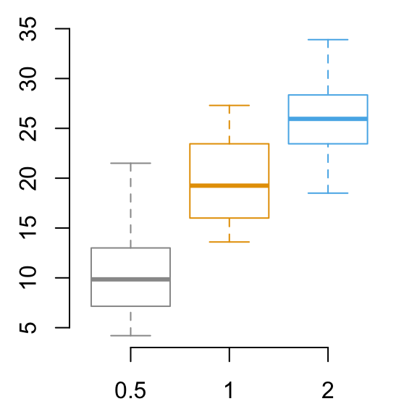
Two or more independent samples

Slide 38
One-way ANOVA (parametric)
Assumptions
Your dependent variable should be measured on a continuous scale.
Your independent variable should consist of two or more categorical, independent groups.
There should be no significant outliers.
Your dependent variable should be approximately normally distributed for each group of the independent variable.
There is need to test homogeneity of variances.
The one-way analysis of variance (ANOVA) is used to determine whether there are any statistically significant differences between the means of two or more independent (unrelated) groups.

Slide 39
One-way ANOVA (parametric)
Hypotheses
H₀: μ₁ = μ₂ = ... = μ_{a}
H₁: At least two means are different
2. Test statistics
F = s_{b}²/ s_{w}²
~ F _{(a-1;n-a)} distribution
3. Decision
- p-value > 0.05 accept H0
Means are statistically equal.
- p-value < 0.05
We can reject H₀, that all the means are equal, and can conclude that at least two of the means are significantly different. These results are displayed in an ANOVA table.

Slide 40
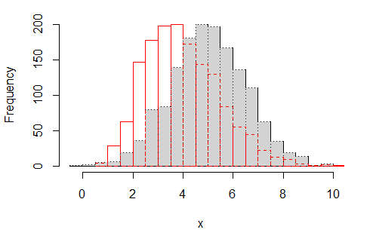
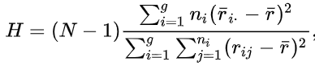
Kruskal-Wallis test
Under the assumption of an identically shaped and scaled distribution for all groups.
1. Hypothesis
Ho: the medians of all groups are equal, and
H₁: at least one population median of one group is different from the population median of at least one other group.
2. Compute the test statistics (in R)
3. Decision based on p-value
If p<0.05 reject the null hypothesis (Ho)

Slide 41
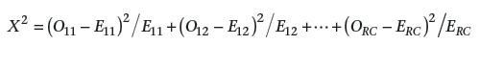
Chi-square test for independence
Assumptions
Your two variables should be measured at a nominal level (i.e., categorical data).
Your two variables should consist of two or more categorical, independent groups.
The expected counts should be larger than 5 in more than 75% of cases.
The chi-square test for independence, also called Pearson's chi-square test or the chi-square test of association, is used to discover if there is a relationship between two categorical variables.
Hypotheses
H₀: Variables are independent
H₁: Variables are related
2. Test statistics
3. Decision
P-value < 0.05 reject H₀
Variables are related.
- χ2_{(R-1)(C-1)} distribution

Slide 42
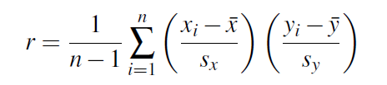
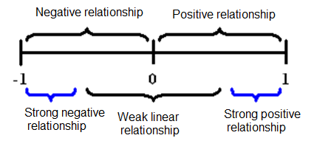
Pearson Correlation
The Pearson product-moment correlation coefficient (Pearson’s correlation, for short) is a measure of the strength and direction of association that exists between two variables measured on at least an interval scale.
Assumptions
Your two variables should be measured at the interval or ratio level (i.e., they are continuous).
There is a linear relationship between your two variables. You can check by creating a scatterplot.
There should be no significant outliers.
Your variables should be approximately normally distributed
Cohen (1988):
|r| <0.3 Weak
0.3 ≤|r| < 0.5 Medium
|r| ≥0.5 Strong

Slide 43
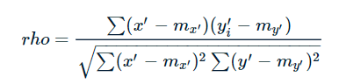
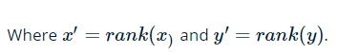
Spearman Correlation (nonparametric)
1. When normality assumption is violated use Spearman correlation.
2. Compute the Spearman correlation coefficient and p-value in R.
3. Decision based on p-value
If p<0.05 reject the null hypothesis (Ho)
There is an association between variables.

Slide 44
R application
Check R Notebooks:
Parametric tests
Nonparametric tests

Slide 45
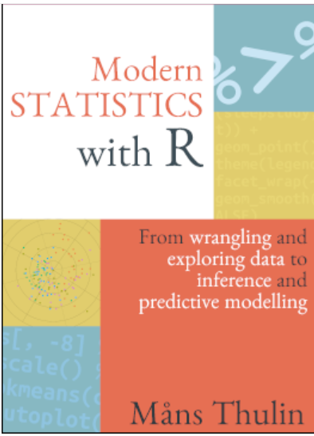

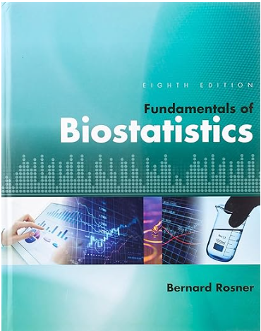
Recommended books
https://www.modernstatisticswithr.com/
https://web.stanford.edu/class/bios221/book/00-chap.html

Slide 46
References/Useful links
Rosner, Bernard. Fundamentals Of Biostatistics. Cengage Learning, 2011.
Pezzullo, John. Biostatistics For Dummies. Wiley, 2013.
Kloke, J., & McKean, J.W. (2014). Nonparametric Statistical Methods Using R (1st ed.). Chapman and Hall/CRC. https://doi.org/10.1201/b17501
http://www.biostathandbook.com/HandbookBioStatThird.pdf

